Slide 1
Smart plant watering system and data logger
Borski, Výlet

Slide 2
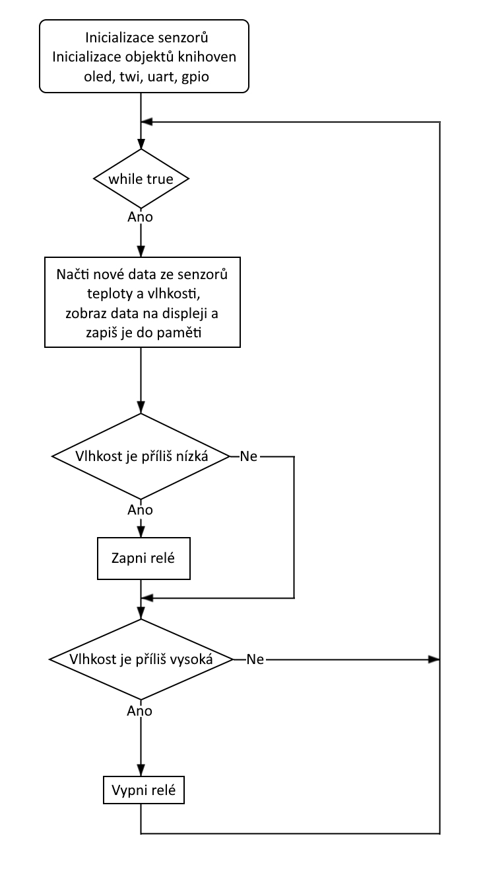

Slide 3
